Slide 1

Project name: Next-Day Stock Price Forecast
Subject: Deep Learning
Project Link: https://github.com/paolosilv/deep-learning2023
Student: Paolo Silvestri
Student ID: 521343

Slide 2
Project Goals
Next day stock closing price (short-term prediction)
Should I buy or sell for tomorrow?

Slide 3
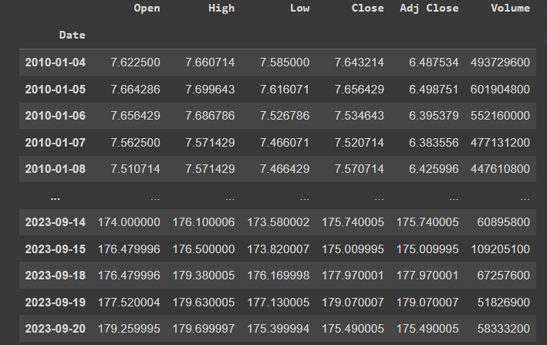
Data
Stock Symbol: AAPL -> APPLE
Provider: Yahoo Finance
Data Period: 2010-01-01 -> 2023-09-21
Primary Data Structure:

Slide 4
Data Pre-Processing
Just the «Close» column feature
Data scaling -> MinMaxScaler
Training sequence -> 5 days

Slide 5
Data Splitting
Train size -> 85% -> 2929 rows
Test size -> 15% -> 518 rows
Batch size -> 64

Slide 6
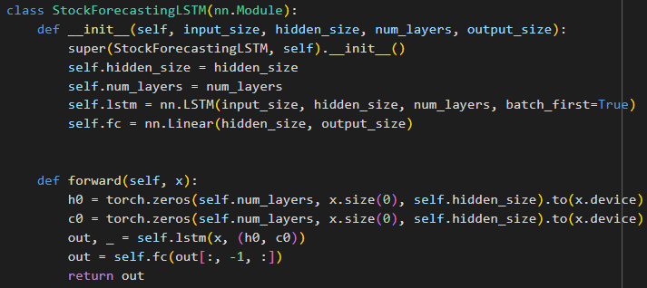
Model Structure
LSTM -> 2 Layers | 64 Hidden Size
Fully Connected -> 1 Output

Slide 7
Loss and Optimizer
Loss Metric -> MSE (Mean Squared Error)
= (1/n) * Σ(yᵢ - ŷᵢ)²
Optimizer -> ADAM (Adaptive Moment Estimation)

Slide 8
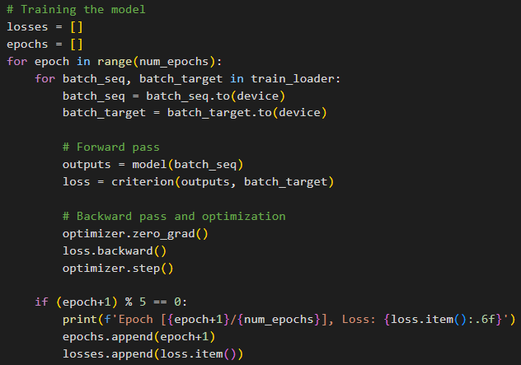
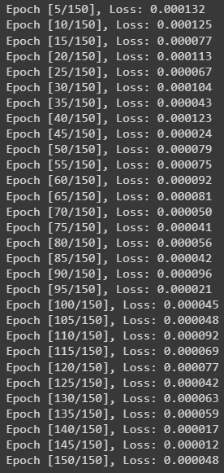
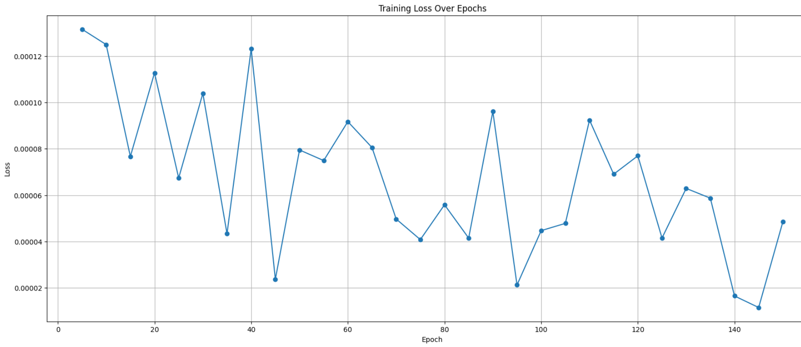
Training
Epochs -> 150
Learning Rate -> 0.001

Slide 9
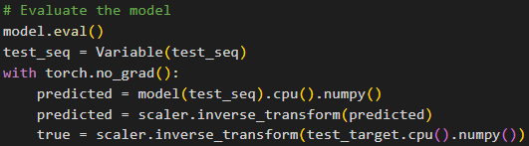

Testing
MSE -> 8.7010
Buy or Sell Accuracy -> 53.38%

Slide 10
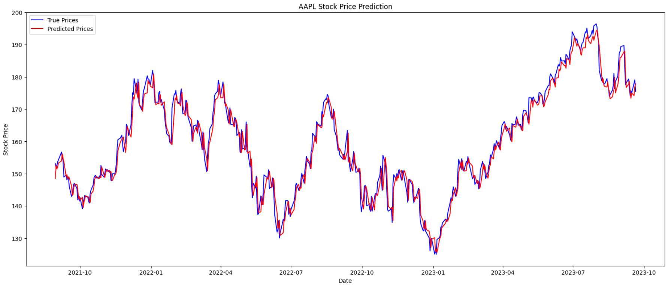
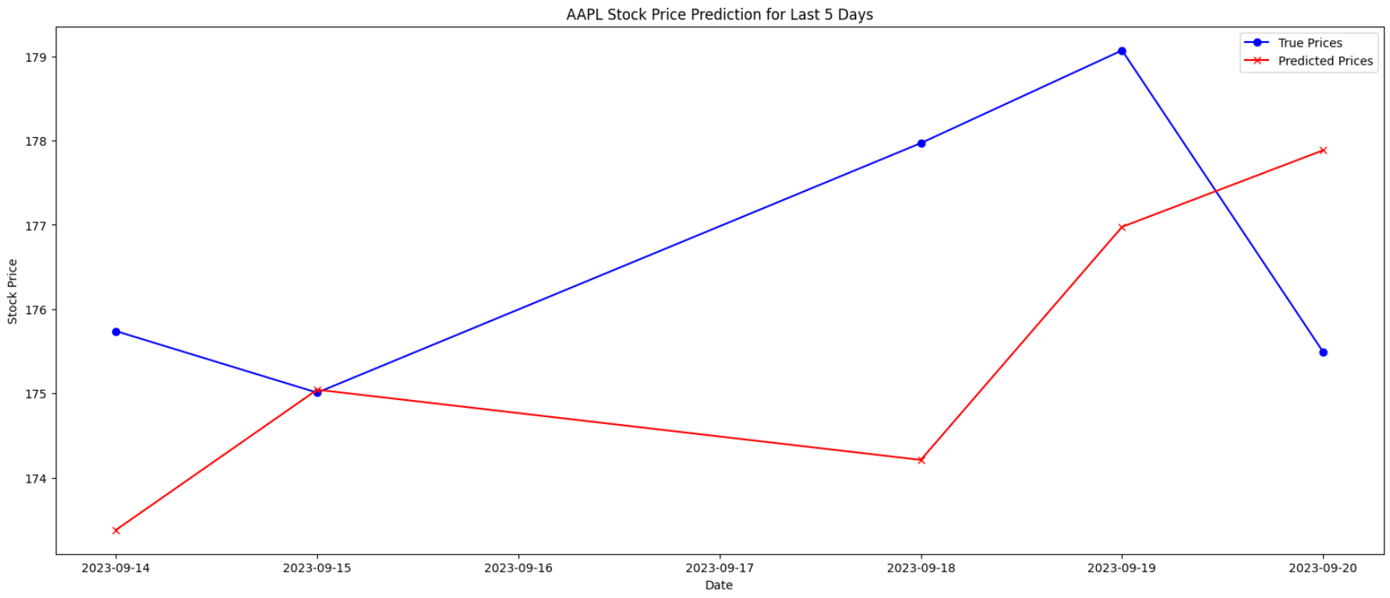

Slide 11
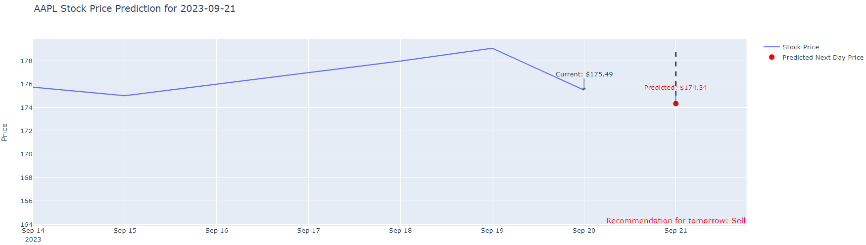
Next Day Prediction -> 2023-09-21
Buy or Sell for tomorrow?

Slide 12
Thank You

